Slide 1
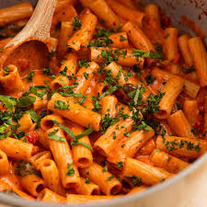
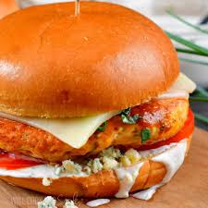

Final Project
FOOD IMAGE CLASSIFICATION
Using Transfer Learning
Group 10
Mounika Teppola & Bala Swapnika Gopi

Slide 2







Core Objectives
Model Adaptation
Data Transformation
Robustness
Fine-tune a pretrained deep learning backbone for high-accuracy food category detection.
Analyze the impact of data augmentation and synthetic data generation on performance.
Analyze performance under distribution shifts: noise, blur, occlusion, lighting etc.

Slide 3
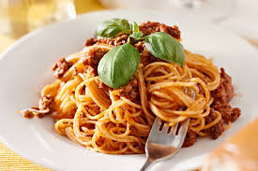

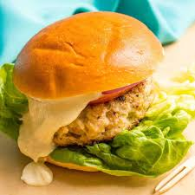
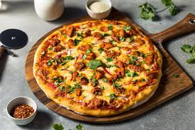
Dataset Overview
Self-Collected Samples
Classes: Pizza, Sushi, Burger, Pasta, Salad, Spaghetti
Balanced: 55 images per class
330 Total Images
Split: Train (210), Val (60), Test (60)

Slide 4

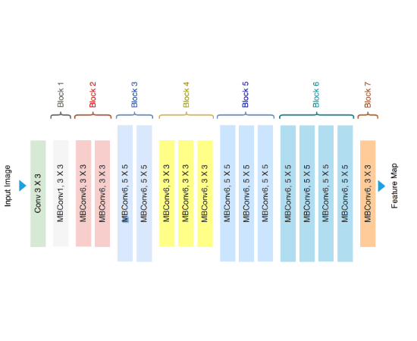
Architecture: EfficientNet-B0
Why EfficientNet?
Leverages compound scaling for better depth/width/resolution balance.
•
Lightweight compared with larger CNNs such as ResNet-50
•
Highly effective for small datasets.
•
Pretrained on ImageNet for rich feature extraction.

Slide 5
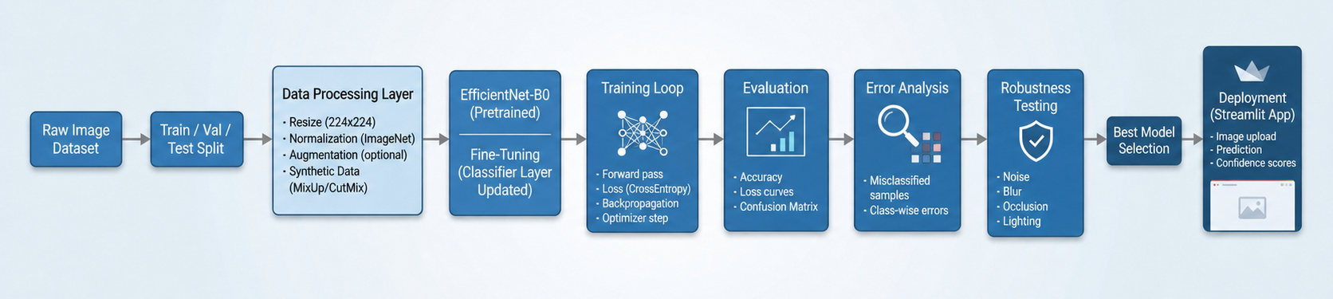
System Architecture

Slide 6




Experimental Setup
Baseline
Augmentation
Synthetic
Syn + Aug
Original dataset without any transformations or synthetic additions
Applying real-world transformations to increase data variety.
Including generated images in the dataset
Synthetic data merged with augmentation techniques.

Slide 7

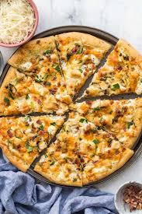
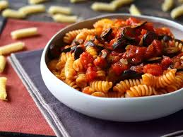
Baseline Performance
Sample Images
86.67%
Test Accuracy
Observations reveal fast convergence but high validation fluctuations.
Verdict: Model struggles with generalization.

Slide 8
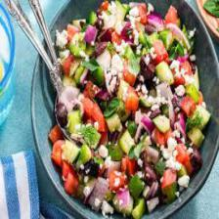
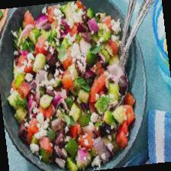
Impact of Augmentation
93.3%
Original Image
Augmented Image
Test Accuracy
Transforms like Rotation, Flip and Jitter force the model to learn invariant features.
Slower initial learning phase.
Significantly more stable validation curve.
Reduction in overfitting gaps.

Slide 9
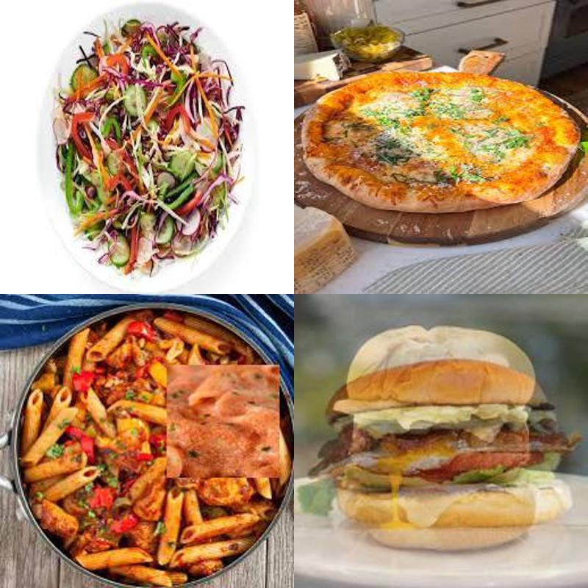
Synthetic Data Generation
93.33%
MixUp + CutMix
- Blending images from the same class maintains label integrity while increasing diversity.
- Achieves similar boosts to manual augmentation but with higher training complexity.

Slide 10
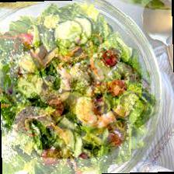
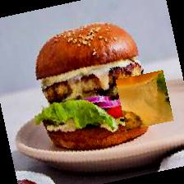
Synthetic + Augmentation
96.67%
Sample Images
The Best Model
Combining synthetic blending with geometric transforms yielded near perfect validation scores (~99%).
Conclusion: Best generalization and classification performance observed.

Slide 11
Results Comparison
Configuration | Test Accuracy | Status
Baseline | 86.67% | Underperforming
Augmentation | 93.33% | Stable
Synthetic | 93.33% | Stable
Synthetic + Augmentation | 96.67% | Best Model

Slide 12
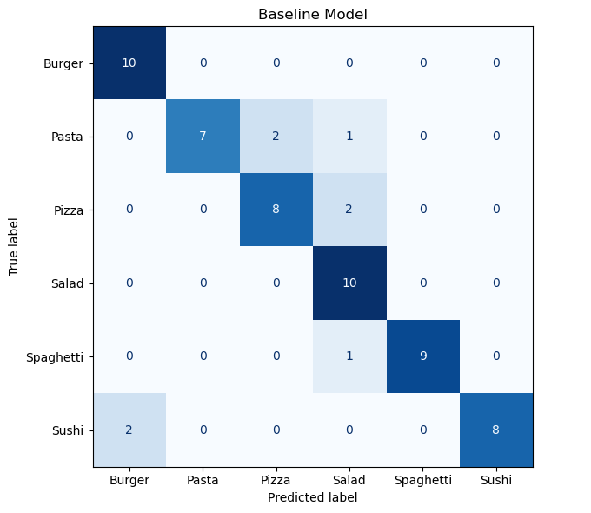
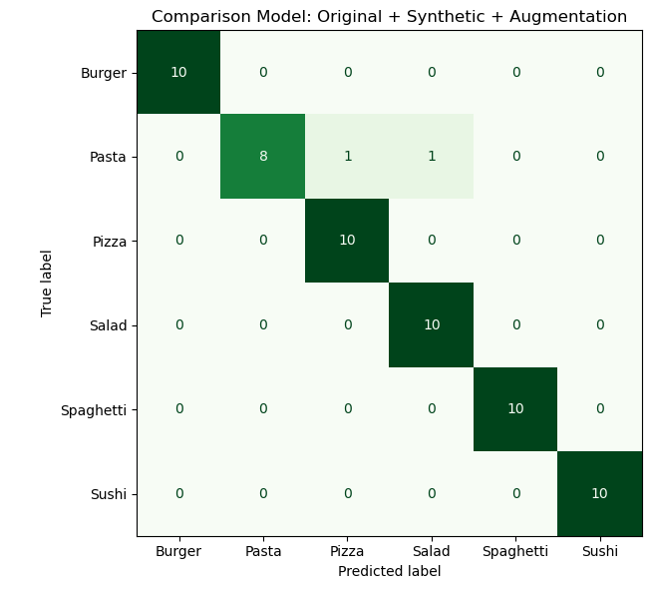


Confusion Matrix Insights
Baseline Errors
Best Model
Pasta → Pizza / Salad
Almost perfect classification
Sushi → Burger
Very few misclassifications
Spaghetti → Salad
Superior class separation.

Slide 13
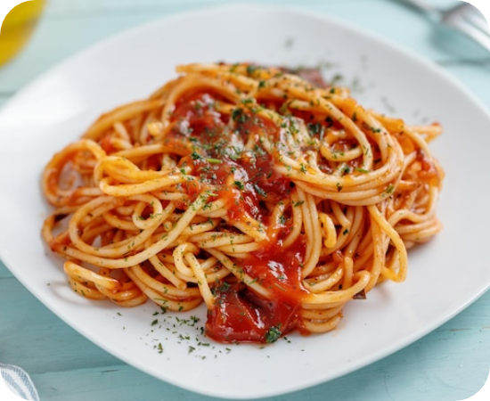
Detailed Error Analysis
The Pasta Challenge
Pasta remains the hardest class to classify correctly across all models.
•
Shared texture with Salad and Pizza toppings.
•
Fine-grained differences are lost in low resolution.
•
Model often confuses pasta strands with salad components.

Slide 14
Error Summary Count
True Class | Baseline Errors | Best Model Errors
Pasta | 3 | 2
Pizza | 2 | 0
Spaghetti | 1 | 0
Sushi | 2 | 0

Slide 15
Robustness Testing
Condition | Accuracy | Severity
Clean | 96.67% | -
Blur | 95.00% | Low Impact
Occlusion | 96.67% | No Impact
Noise | 66.67% | Critical Weakness
Lighting | 61.67% | Critical Weakness

Slide 16






Robustness Insights
Lighting (61.67%)
Noise (67%)
Structural Strength
Model relies heavily on color distributions that shift in extreme light.
Pixel-level disturbances significantly affect prediction accuracy.
Blur and Occlusion barely drop accuracy. Model prioritizes global structures.

Slide 17
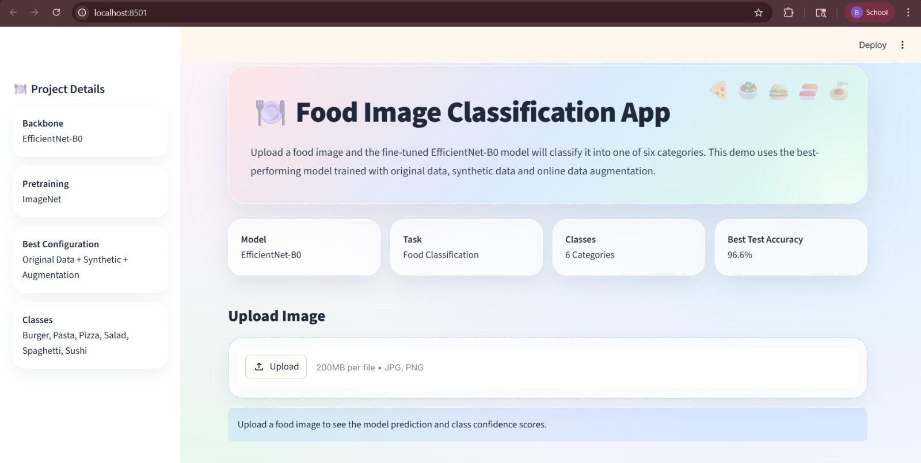
Demo UI
- Designed an intuitive web interface for deploying the trained classification model.
- Allows users to upload images and instantly view predictions with confidence metrics

Slide 18
Limitations & Future Work
Limitations
Future Work
• Lighting variations drop (61.67%)
• Add lighting-based augmentation
• Sensitive to noise (66.67%)
• Improve synthetic data realism
• Confusion in similar classes (Pasta vs Pizza)
• Increase dataset diversity
• Explore EfficientNet variants

Slide 19

Summary of Findings
Transfer Learning Power: EfficientNet-B0 adapted perfectly to small, custom datasets with minimal training time.
Data Strategy: Combining synthetic data (diversity) with augmentation (robustness) is the winning formula.
Future Challenges: Lighting variations and fine grained texture similarities (Pasta vs Pizza) remain key research areas.

Slide 20


THANK YOU!
Questions?
Mounika Teppola & Bala Swapnika Gopi

